Slide 1
cit Weight watchers
Sinéad Coughlan, Dean Healy,
James Broderick and Megan McCarthy

Slide 2
Vision Statement
We are providing an application to help all our members achieve the body and lifestyle of their dreams. The application was designed by students, to help students and staff with weight management in order to keep CIT a healthy campus. By using the free CIT Weight Watchers app, students will be able to monitor their exercise, diet and weight trends. The goal is for users to feel comfortable in a judgement-free environment and strive towards gaining their perfect body. The app is designed to be simple and easy to use, and will work on most modern day smartphones. We work together, in a constructive environment, to meet the needs of our users and provide the best app possible.

Slide 3
Our Users

Slide 4
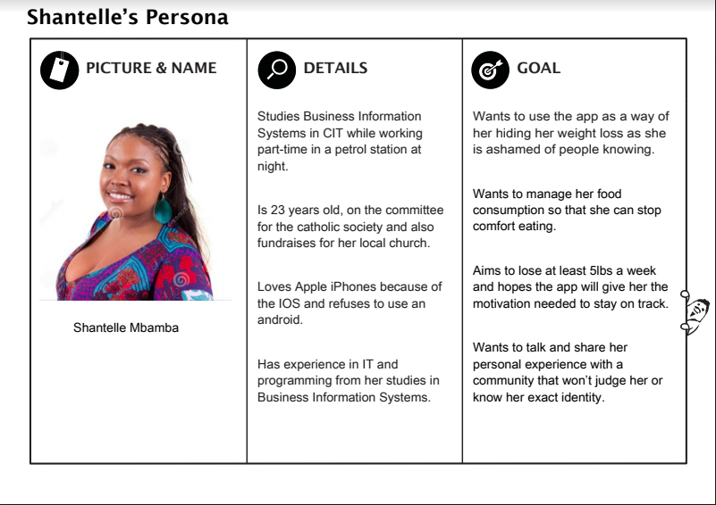

Slide 5
Shantell’s First Scenario
Shantelle sits at her table during lunch time and opens the CIT weight watcher app on her phone
Shantelle proceeds to login by providing her mycit email address and password
Shantelle scans the homepage of the app and clicks onto the “Diet” tab
Shantelle then uses the drop-down menu to look at her diet information for yesterday
Shantelle reads the page before exiting the app.

Slide 6
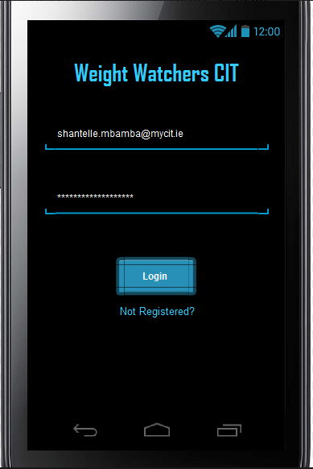

Slide 7
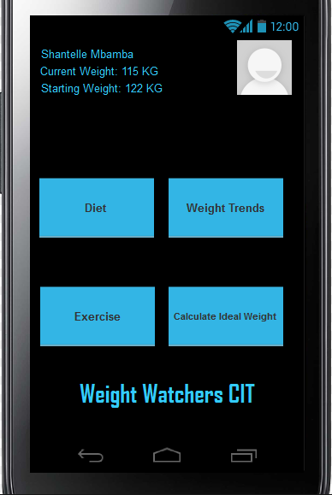

Slide 8
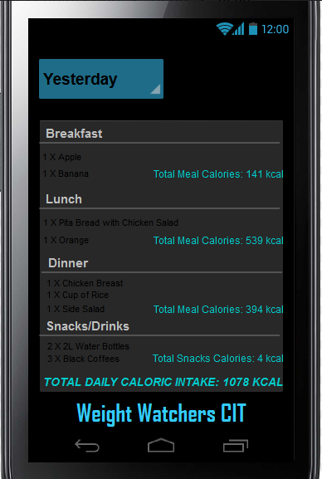

Slide 9
Shantelle’s Second Scenario
Shantelle opens the CIT weight watcher app on her phone while eating her dinner
Shantelle proceeds to login by providing her mycit email address and password
Shantelle scans the homepage of the app and clicks on the “Diet” tab
Shantelle lands on the page for today’s dietary information
Shantelle has already entered the information for the food she consumed at breakfast and lunch and now wants to add the information from her dinner
Shantelle clicks on the textbox in the dinner section
Shantelle then enters the food that she ate for her dinner and the application adds the calories to the total count.
Shantelle looks at her new total before closing the app.

Slide 12
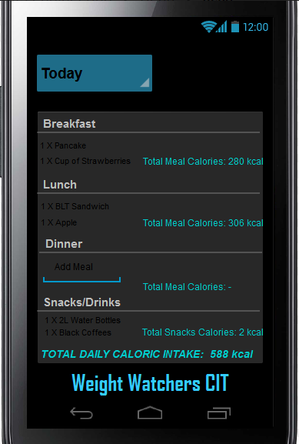

Slide 13
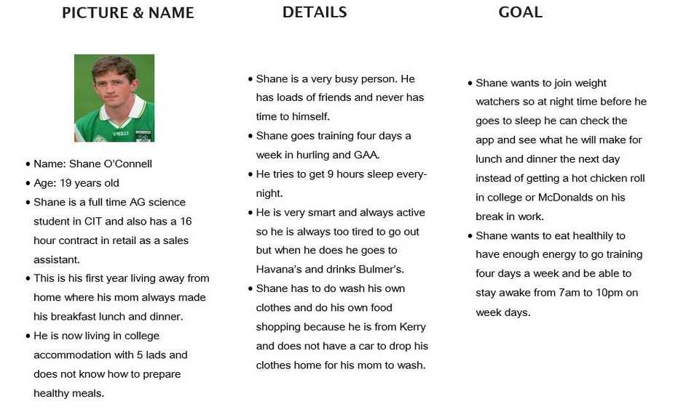

Slide 14
Shane’s Scenario
Shane doesn't know what to have for dinner.
Shane decides that he does not want anything unhealthy for dinner so he opens the Weight watchers app.
Shane is asked to enter his mycit email as his username and his mycit password as his password.
After Shane logs in he selects the diet option.
Shane looks at what he has in his fridge and choses a recipe with the things that he has available.
Shane calls his mom to find out how to cook chicken safely.
Shane screenshots the recipe and logs out of the app.

Slide 15
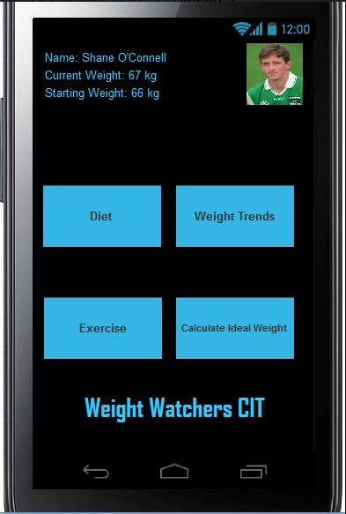

Slide 16
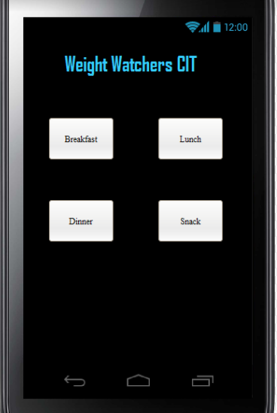

Slide 17
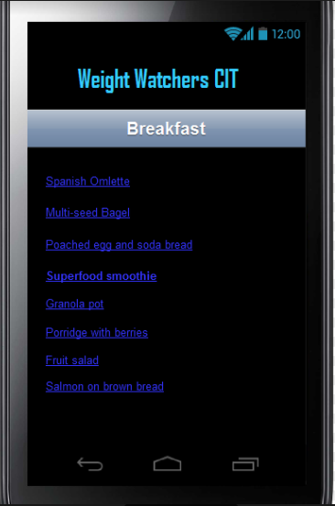

Slide 18
Shanes scenario
Shane feels as though he has gained some weight over freshers weeks so he decides to log into his weight watchers app.
Shane is asked to enter his mycit email as his username and his mycit password as his password.
After shane has logged in successfully he chooses the weight trends options.
Shane decides to weigh himself to see if he is up or down weight from the last time he logged on.
Shane sees that in one week he has gained 1.9kgs from eating bad foods and not going training.
Shane enters his new weight into the app and the graph changes accordingly by reading shane’s old weight and his current weight and finding the difference between the two.
Shane decided to get his gear and go training so he logs off the app.

Slide 19
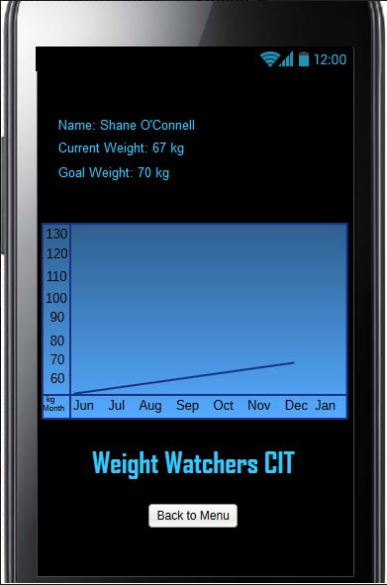

Slide 20
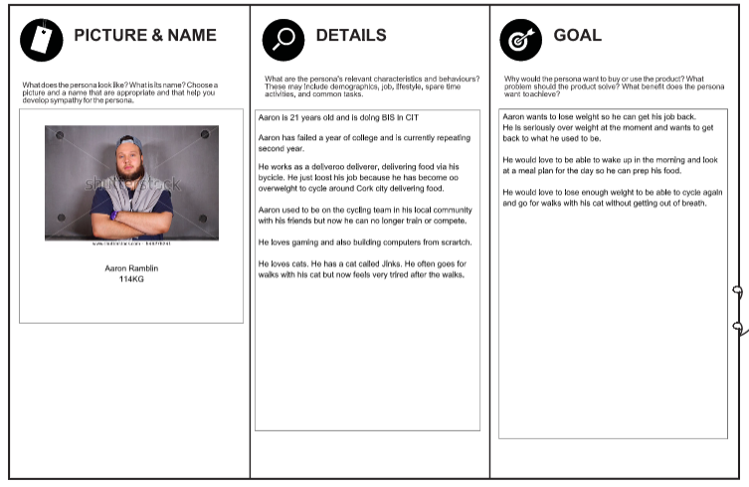

Slide 21
Scenario 7
Aaron wakes up in the morning after a night out
Aaron weighs himself every morning to find out what weight he has lost
Aaron goes onto the weight watchers app and updates his weight
He has put on 1 KG
He wonders to himself what his bmi is now
He opens the section where you can check your bmi
He types in his weight and his height and realises his bmi has gone up
This makes Aaron work harder today to lose weight

Slide 22
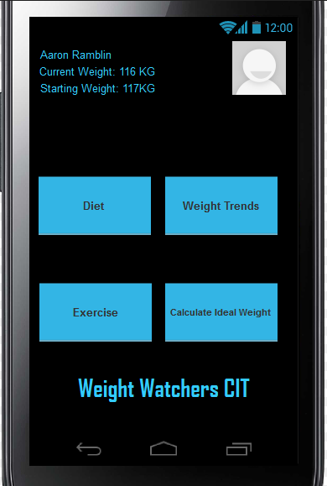

Slide 23
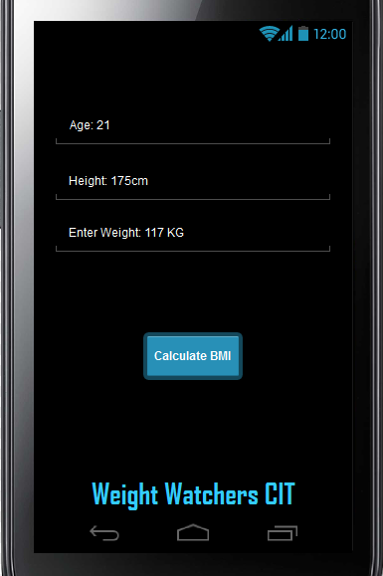

Slide 24
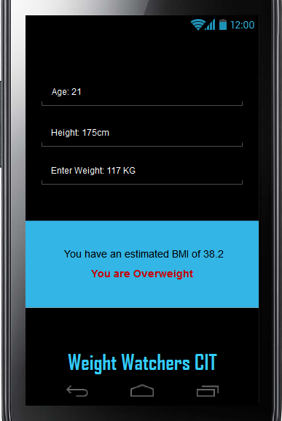

Slide 25
Scenario 8
Aaron attends a weight watchers class
He is asked what his bmi was last week
He checks his bmi which he has been updating all the time
He goes back to the exact date he was asked
He then hits enter where his result for the date chosen comes up
He tells his weight watcher instructor and she is very impressed with this app
He is delighted with his result to date

Slide 26
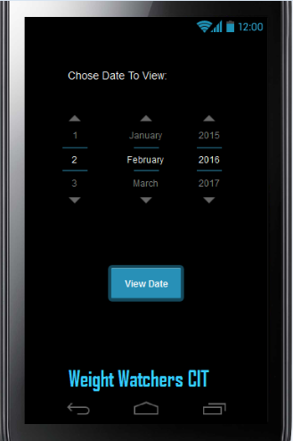

Slide 27
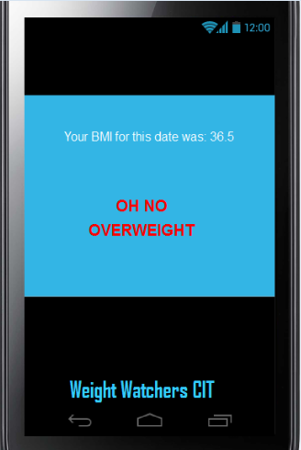

Slide 28
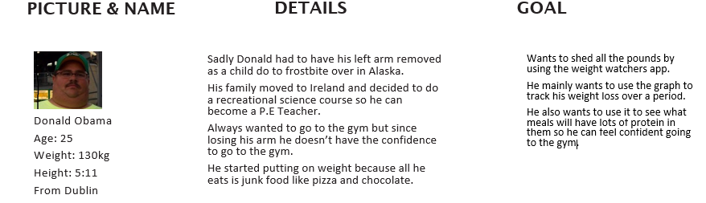

Slide 29
Donald
Late Friday evening, and Donald just got home from CIT. He wants to use the CIT weight watchers application to see what exercises he can do for 30 minutes.
He opens the app on his phone and goes to the log in page. He puts in his CIT email and password.
The app brings him to the home page where it shows his picture, his name, his current weight and starting weight when he first started using the app.
Donald then press the exercise button.
On the exercise page it had four different option Running, Swimming, Yoga or Dancing.
Donald presses the running button which then shows him how many calories he will lose in an hour, 30 minutes and 15 minute.
Donald decides to do the 30 minute running exercise.
Once done he goes back to the home screen and logouts.
Donald then closes the application.

Slide 30
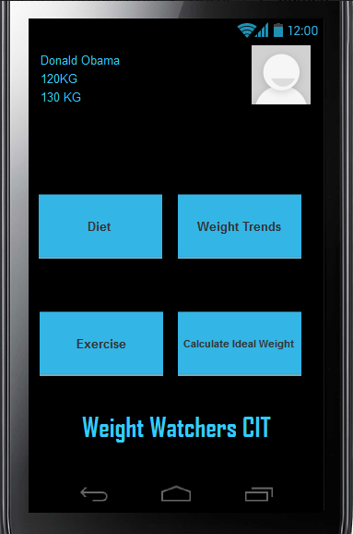

Slide 31
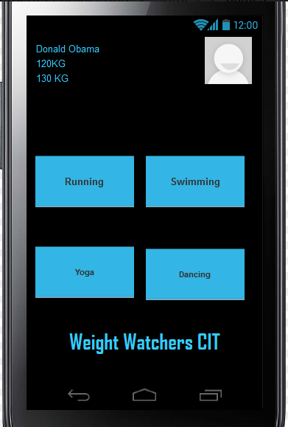

Slide 32
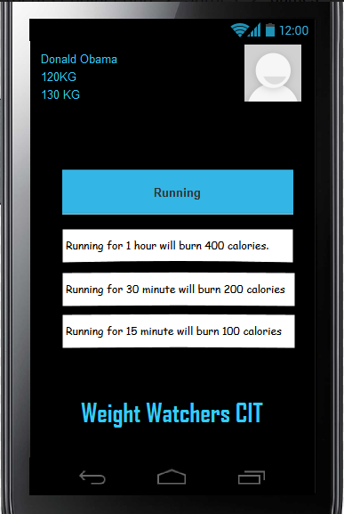

Slide 33
Donald
It’s Sunday and Donald is looking to treat himself with a snack after a hard week of exercise and dieting
First he wants to check home much weight he lost over the course of the week.
He opens up the CIT weight watcher app.
He logins in using his CIT email and password.
At the home screen he clicks on weight trends to see a graph of his weight loss over the week.
After pressing the button the app seems to freeze.
He decides to wait and see if it will work after a few minutes but the application closes itself.
Donald tries the application again and is greeted with a send feedback box on what happened.
He fills out the box describing what happened while trying to use the application.
Then he presses send and an alert box comes up saying thanks for sending your feedback and the problem will be fixed shortly.
Donald closes the application and decides to try it again tomorrow.

Slide 34
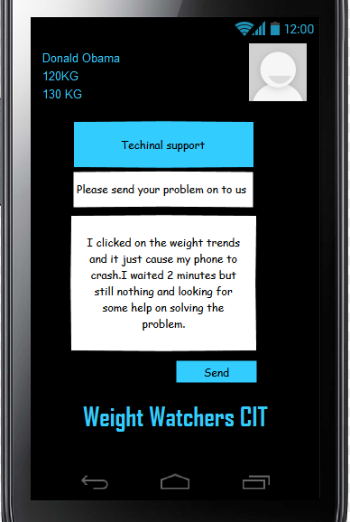

Slide 35
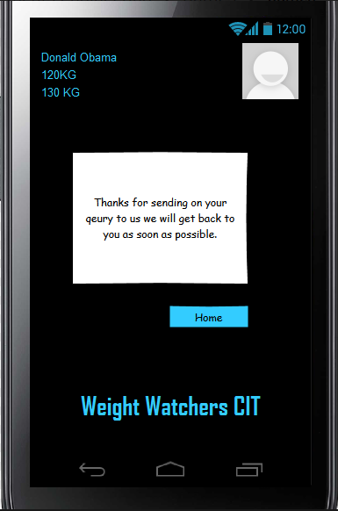

Slide 36
Thank you!
Any Questions?

